Slide 1
Line Calls and Out of Bounds

Slide 2
Things to remember
2-1-3 – The wrestling area shall be marked on the mat by painted lines, 2 in inches wide, which are inbounds.
5-15-1 – Contestants are considered inbounds if the supporting parts or either wrestler are inside or on the boundary lines.

Slide 3
Same as in previous years
If any part of the supporting point is touching out of bounds, it is considered out.
5-15-2 – Supporting points as referenced in your rule book. This means other body parts are supporting points depending on the position and situation.
5-15-3 – Wrestling shall continue as long as the supporting points of either wrestler remain inbounds. If there is no action a the edge of the mat and one wrestler is out of bounds, the referee may stop the match.

Slide 4
Action heading back inbounds
No where does the rules nor the casebook say that if the action is turning back inbounds that action should continue. If they are out of bounds, blow the whistle and restart in the center of the mat.

Slide 5
Out of Bounds
Inbounds
Out of Bounds
Inbounds
Inbounds
Out of Bounds

Slide 6
Inbounds – Continue action
Inbounds area

Slide 7
Inbounds – Continue action
Inbounds area

Slide 8
Out of bounds – Blow the whistle
Inbounds area

Slide 9
Out of bounds – Blow the whistle!
Inbounds area

Slide 10
Inbounds – Continue action
Inbounds area

Slide 11
Inbounds – Continue action
Inbounds area

Slide 12
Inbounds – Continue action
Inbounds area

Slide 13
Inbounds – Continue action
Inbounds area

Slide 14
Out of bounds – Blow the whistle
Inbounds area

Slide 15
Action heading back inbounds
Nowhere does the rules nor the casebook say that if the action is turning back inbounds that action should continue. If they are out of bounds, blow the whistle and restart in the center of the mat regardless of where the momentum might take them.

Slide 16
Edge of mat calls Are these takedowns or not?

Slide 17
Takedown or not?
Out of bounds area

Slide 18
NO TAKEDOWN

Slide 19
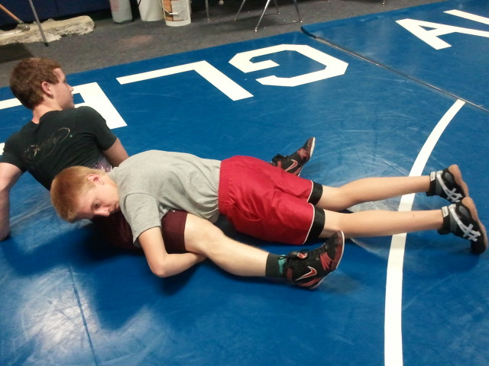
The feet immediately drop down inbounds or on the line
Takedown or not?
Out of bounds area
Out of bounds area

Slide 20
TAKEDOWN

Slide 21
Only one supporting point inbounds
Takedown or not?
Inbounds area

Slide 22
NO TAKEDOWN

Slide 23
Two feet inbounds or on the line
Takedown or not?
Inbounds area

Slide 24
TAKEDOWN

Slide 25
Right foot touching out of bounds
Takedown or not?
Inbounds area

Slide 26
NO TAKEDOWN

Slide 27
Neither has both supporting points inbounds
Takedown or not?
Inbounds area

Slide 28
NO TAKEDOWN

Slide 29
Edge of mat calls Nearfall, fall or out of bounds?

Slide 30
Supporting points of top still inbounds
Inbounds area

Slide 31
Wrestling continues but no near fall points are earned

Slide 32
Neither with two supporting points inbounds
Inbounds area

Slide 33
BLOW THE WHISTLE!
OUT OF BOUNDS

Slide 34
Hips inbounds shoulders on the line
Inbounds area

Slide 35
LOOK FOR THE FALL!
Begin Nearfall count

Slide 36
Hips out of bounds with shoulders on the line
Inbounds area

Slide 37
LOOK FOR THE FALL!
Begin Nearfall count

Slide 38
No out of bounds line on two-tone mat?
There is no change. The entire supporting point must be in the black to be inbounds.
Inbounds area

